Slide 1
LINEAR and LOGISTIC REGRESSION / CLASSIFICATION
Bakul Gohel, Ph.D.
DA-IICT, Gandhinagar

Slide 2
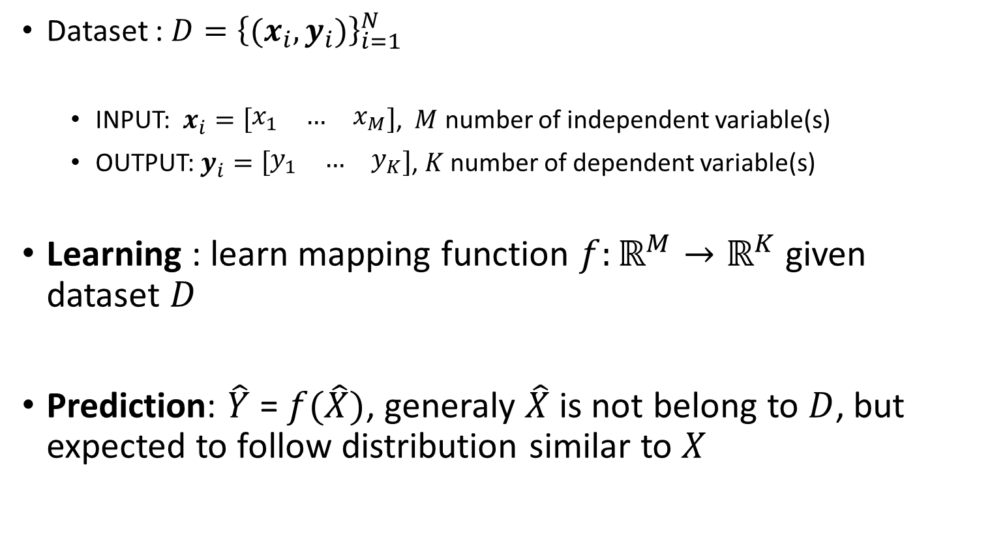
Machine Learning / Deep Learning
Dataset : ${D=\left\{{(x}_{i}, y_{i})\right\}}_{i=1}^{N}$
INPUT: $x_{i}=\left[\begin{matrix}x_{1} & … & x_{M}\end{matrix}\right]$, $M$ number of independent variable(s)
OUTPUT: $y_{i}=\left[\begin{matrix}y_{1} & … & y_{K}\end{matrix}\right]$, $K$ number of dependent variable(s)
Learning : learn mapping function $f:ℝ^{M}→ℝ^{K}$ given dataset $D$
Prediction: $\hat{Y}$ = $f(\hat{X})$, generaly $\hat{X}$ is not belong to $D$, but expected to follow distribution similar to $X$

Slide 3
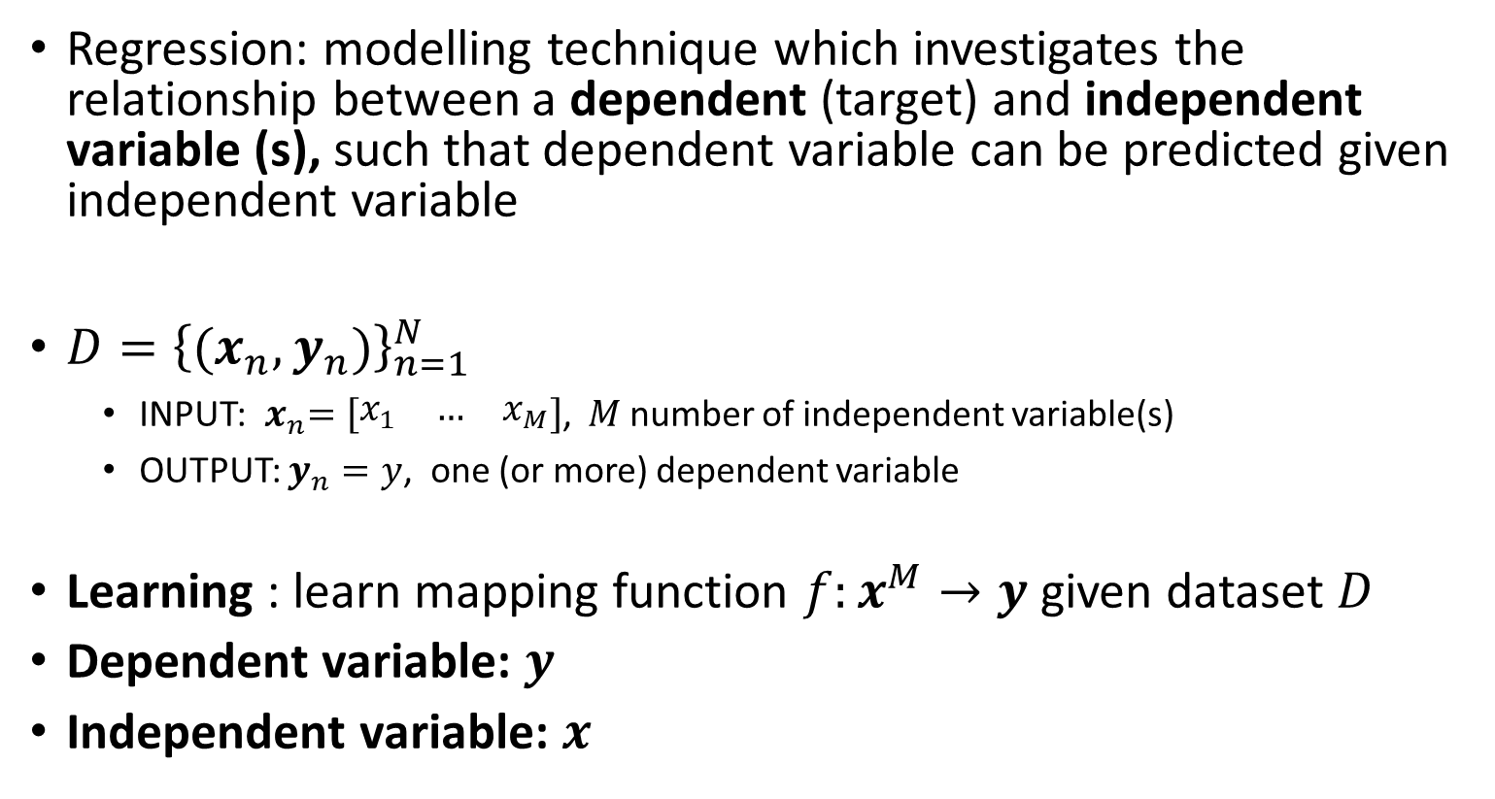
Regression / Classification
Regression: modelling technique which investigates the relationship between a dependent (target) and independent variable (s), such that dependent variable can be predicted given independent variable
${D=\left\{{(x}_{n}, y_{n})\right\}}_{n=1}^{N }$
INPUT:${ x}_{n}=\left[\begin{matrix}x_{1} & … & x_{M}\end{matrix}\right]$, $M$ number of independent variable(s)
OUTPUT: $y_{n}=y$, one (or more) dependent variable
Learning : learn mapping function $f:x^{M}→y$ given dataset $D$
Dependent variable: $y$
Independent variable: $x$

Slide 4
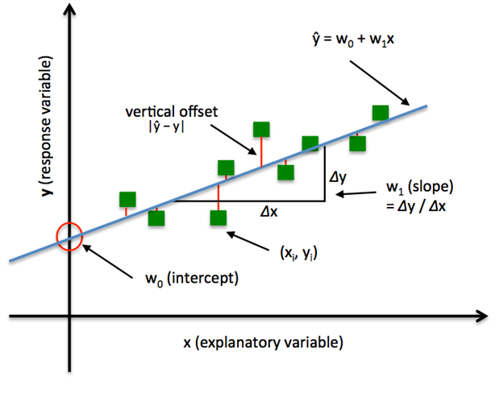
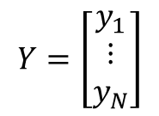


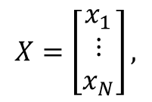

Simple Linear Regression
$$X=\left[\begin{matrix}x_{1} \\ ⋮ \\ x_{N}\end{matrix}\right],$$
$$Y=\left[\begin{matrix}y_{1} \\ ⋮ \\ y_{N}\end{matrix}\right]$$
Given observation or data points
$$y=w_{0}+w_{1}x_{1}$$
$$y=β_{0}+β_{1}x$$
$$y=mx+c$$

Slide 5
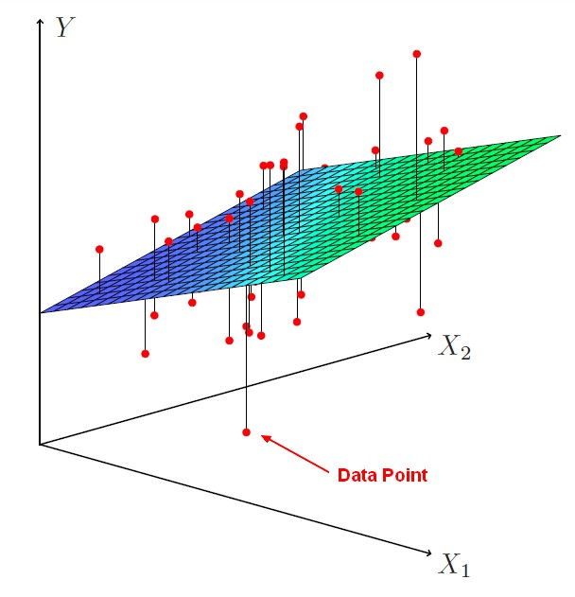
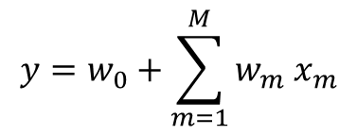
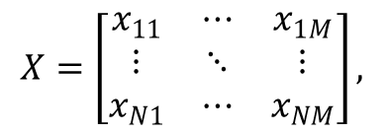
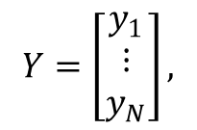
Multiple Linear Regression
$$X=\left[\begin{matrix}x_{11} & ⋯ & x_{1M} \\ ⋮ & ⋱ & ⋮ \\ x_{N1} & ⋯ & x_{NM}\end{matrix}\right],$$
$$Y=\left[\begin{matrix}y_{1} \\ ⋮ \\ y_{N}\end{matrix}\right],$$
Given observations or data points
$$y=w_{0}+\sum_{m=1}^{M}{w_{m} x_{m}}$$

Slide 6


Least Square
$${error, e}_{i}=|y_{i}− {\hat{y}}_{i}|$$
$$find the best fiting model \left(line, plane, or hyperplane\right) that minimize$$
$$the approximation error or loss or COST (E)$$
$$E=\sum_{n=1}^{N}{e_{i}=\sum_{n=1}^{N}{\left|y_{n}− {\hat{y}}_{n}\right| }}$$
$$that means find{ w}^{∗} such that it minimize E$$

Slide 7

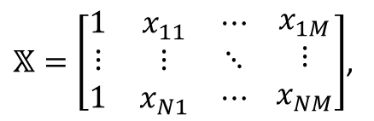

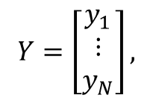
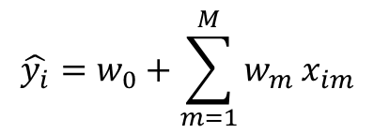
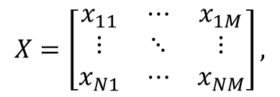
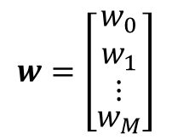
Least Square
$$Y=\left[\begin{matrix}y_{1} \\ ⋮ \\ y_{N}\end{matrix}\right],$$
$$X=\left[\begin{matrix}x_{11} & ⋯ & x_{1M} \\ ⋮ & ⋱ & ⋮ \\ x_{N1} & ⋯ & x_{NM}\end{matrix}\right],$$
$𝕏=\left[\begin{matrix}1 & x_{11} & ⋯ \\ ⋮ & ⋮ & ⋱ \\ 1 & x_{N1} & ⋯\end{matrix} \begin{matrix}x_{1M} \\ ⋮ \\ x_{NM}\end{matrix}\right]$,
$$w=\left[\begin{aligned}\begin{matrix}w_{0} \\ w_{1} \\ ⋮\end{matrix} \\ w_{M}\end{aligned}\right]$$
$$\hat{y_{i}}=w_{0}+\sum_{m=1}^{M}{w_{m} x_{im}}$$
$$⟹$$
$$\hat{Y}=𝕏w$$

Slide 8
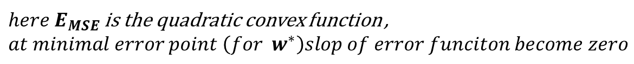
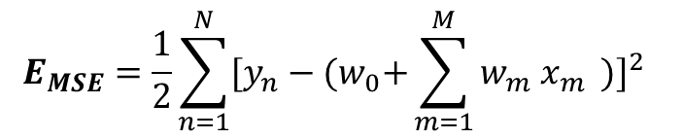
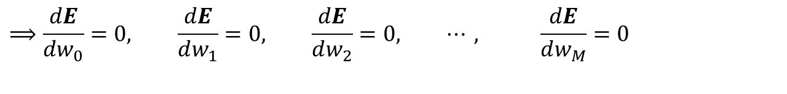
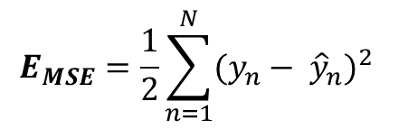
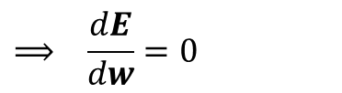
Least Square / Mean Square Error
$$E_{MSE}=\frac{1}{2}\sum_{n=1}^{N}{{(y_{n}− {\hat{y}}_{n})}^{2} }$$
$$E_{MSE}=\frac{1}{2}\sum_{n=1}^{N}{{[y_{n}−{(w}_{0}+\sum_{m=1}^{M}{w_{m} x_{m}} )]}^{2} }$$
$$find{ w}^{∗} such that it minimizeE_{MSE}$$
$here E_{MSE}$ is the quadratic convex function , $at minimal error point \left(for{ w}^{∗}\right)slop of error funciton become zero$
$$⟹ \frac{dE}{dw}=0$$
$$⟹\frac{dE}{dw_{0}}=0, \frac{dE}{dw_{1}}=0, \frac{dE}{dw_{2}}=0, ⋯, \frac{dE}{dw_{M}}=0$$

Slide 9
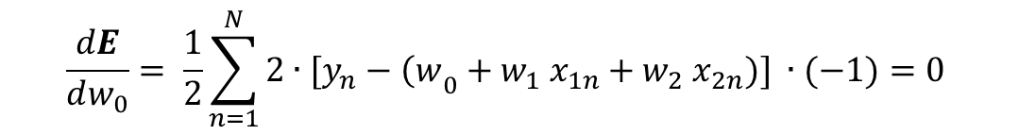
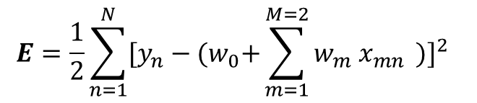

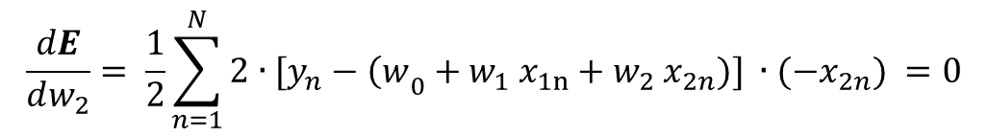
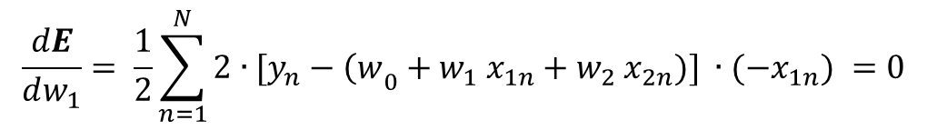
Least Square
$$f:ℝ^{M=2}→ℝ$$
$$E=\frac{1}{2}\sum_{n=1}^{N}{{[y_{n}−{(w}_{0}+\sum_{m=1}^{M=2}{w_{m} x_{mn}} )]}^{2} }$$
$$\frac{dE}{dw_{0}}= \frac{1}{2}\sum_{n=1}^{N}{{2∙[y}_{n}−{\left(w\right.}_{0}+w_{1} x_{1n}+w_{2} x_{2n})] ∙(−1)=0 }$$
$$\frac{dE}{dw_{1}}= \frac{1}{2}\sum_{n=1}^{N}{{2∙[y}_{n}−{\left(w\right.}_{0}+w_{1} x_{1n}+w_{2} x_{2n})] ∙(−x_{1n}) }=0$$
$$\frac{dE}{dw_{2}}= \frac{1}{2}\sum_{n=1}^{N}{{2∙[y}_{n}−{\left(w\right.}_{0}+w_{1} x_{1n}+w_{2} x_{2n})] ∙(−x_{2n}) }=0$$

Slide 10
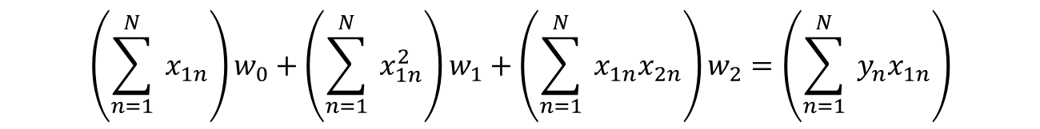
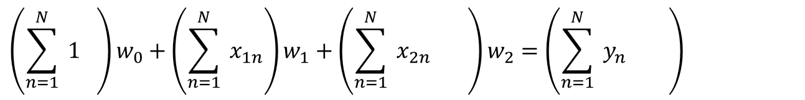
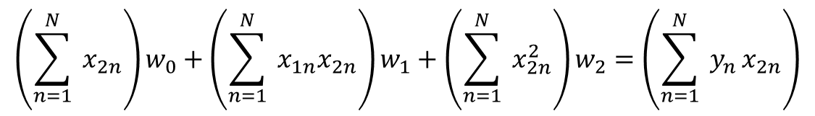
Least Square
$$\left(\sum_{n=1}^{N}{ 1} \right)w_{0}+\left(\sum_{n=1}^{N}{ x_{1n}}\right)w_{1}+\left(\sum_{n=1}^{N}{ x_{2n}} \right)w_{2}=\left(\sum_{n=1}^{N}{ y_{n}} \right)$$
$$\left(\sum_{n=1}^{N}{ x_{1n}}\right)w_{0}+\left(\sum_{n=1}^{N}{ x_{1n}^{2}}\right)w_{1}+\left(\sum_{n=1}^{N}{ x_{1n}x_{2n}}\right)w_{2}=\left(\sum_{n=1}^{N}{ y_{n}x_{1n}}\right)$$
$$\left(\sum_{n=1}^{N}{ x_{2n}}\right)w_{0}+\left(\sum_{n=1}^{N}{ x_{1n}x_{2n}}\right)w_{1}+\left(\sum_{n=1}^{N}{ x_{2n}^{2}}\right)w_{2}=\left(\sum_{n=1}^{N}{ y_{n}}x_{2n}\right)$$

Slide 11
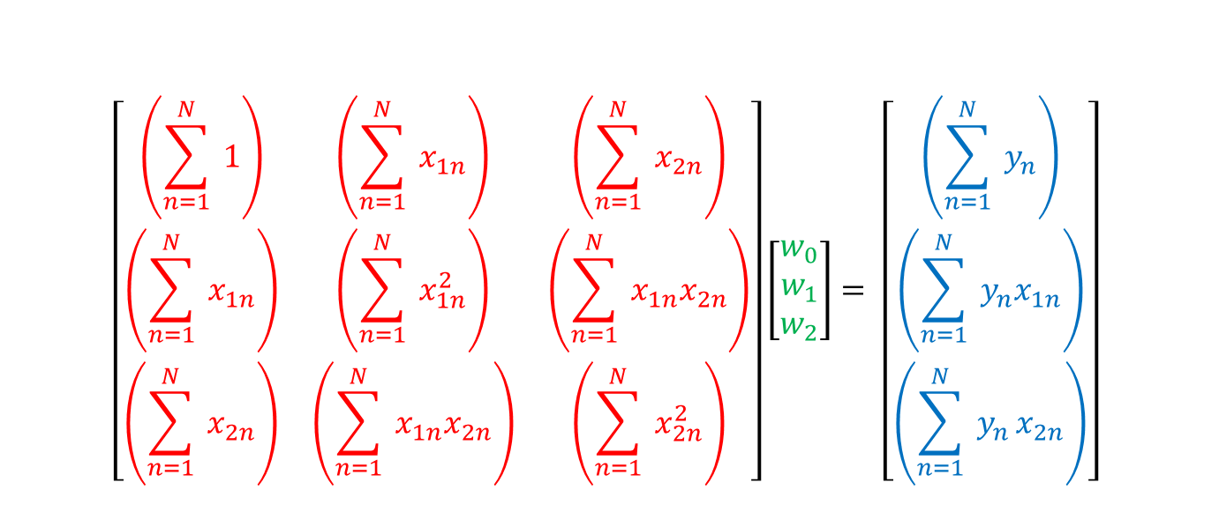
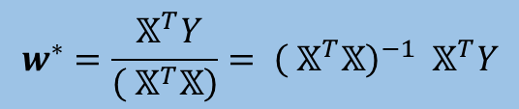
Least Square
$$\left[\begin{matrix}\left(\sum_{n=1}^{N}{ 1}\right) & \left(\sum_{n=1}^{N}{ x_{1n}}\right) & \left(\sum_{n=1}^{N}{ x_{2n}}\right) \\ \left(\sum_{n=1}^{N}{ x_{1n}}\right) & \left(\sum_{n=1}^{N}{ x_{1n}^{2}}\right) & \left(\sum_{n=1}^{N}{ x_{1n}x_{2n}}\right) \\ \left(\sum_{n=1}^{N}{ x_{2n}}\right) & \left(\sum_{n=1}^{N}{ x_{1n}x_{2n}}\right) & \left(\sum_{n=1}^{N}{ x_{2n}^{2}}\right)\end{matrix}\right]\left[\begin{matrix}w_{0} \\ w_{1} \\ w_{2}\end{matrix}\right]= \left[\begin{matrix}\left(\sum_{n=1}^{N}{ y_{n}}\right) \\ \left(\sum_{n=1}^{N}{ y_{n}x_{1n}}\right) \\ \left(\sum_{n=1}^{N}{ y_{n}}x_{2n}\right)\end{matrix}\right]$$
$$\left({ 𝕏}^{T}𝕏\right){ w}^{∗} = { 𝕏}^{T}Y$$
Least Square close form Solution
$$w^{∗}=\frac{{ 𝕏}^{T}Y}{\left({ 𝕏}^{T}𝕏\right)}= {\left({ 𝕏}^{T}𝕏\right)}^{−1} { 𝕏}^{T}Y$$

Slide 12
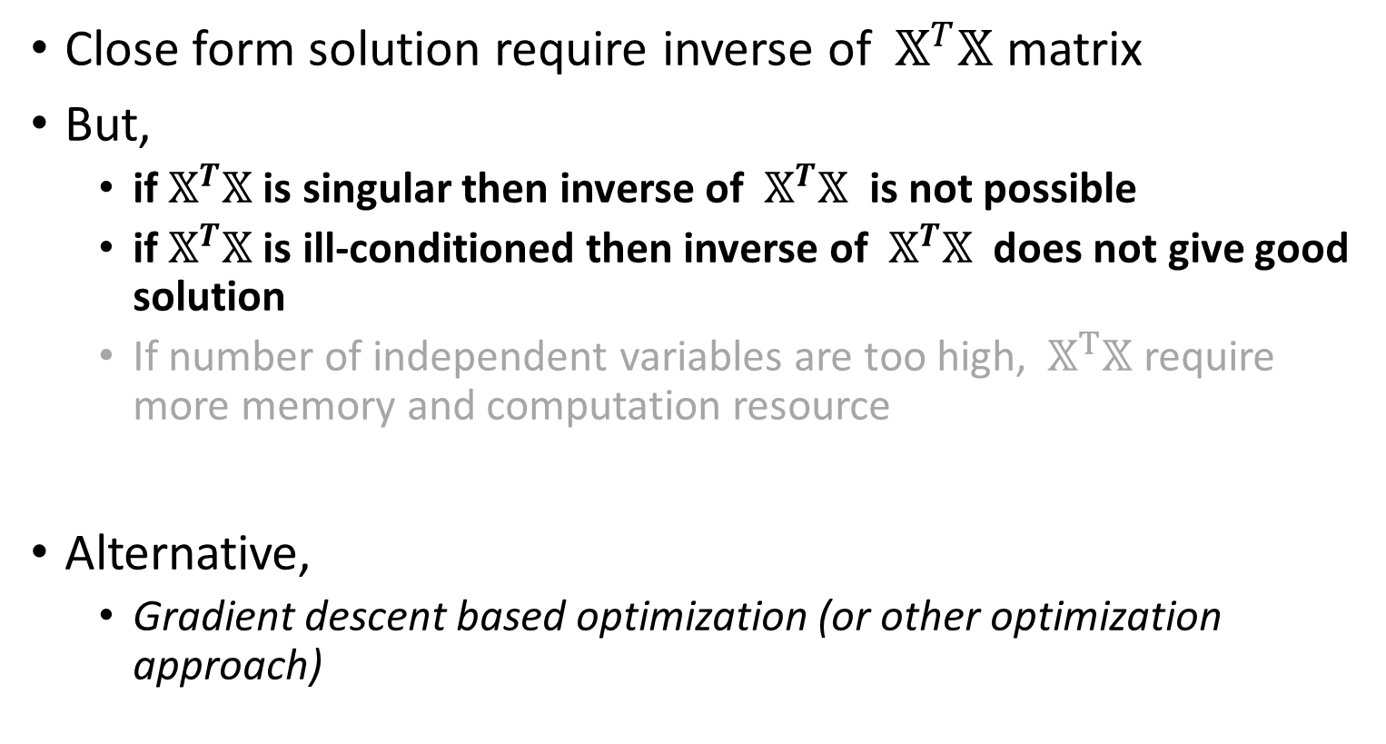
Least Square
Close form solution require inverse of ${ 𝕏}^{T}𝕏$ matrix
But,
if${ 𝕏}^{T}𝕏$ is singular then inverse of ${ 𝕏}^{T}𝕏$ is not possible
if${ 𝕏}^{T}𝕏$ is ill-conditioned then inverse of ${ 𝕏}^{T}𝕏$ does not give good solution
If number of independent variables are too high, ${ 𝕏}^{T}𝕏$ require more memory and computation resource
Alternative,
Gradient descent based optimization (or other optimization approach)

Slide 13


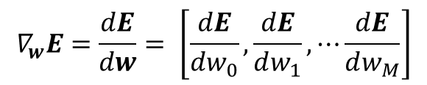


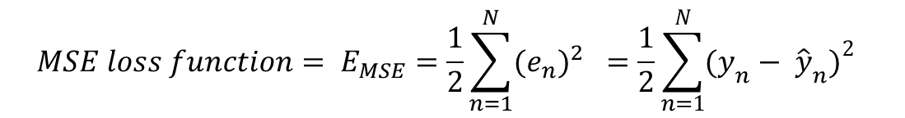
Least Square
$${MSE loss function= E}_{MSE}=\frac{1}{2}\sum_{n=1}^{N}{{(e_{n})}^{2} }=\frac{1}{2}\sum_{n=1}^{N}{{(y_{n}− {\hat{y}}_{n})}^{2} }$$
$$find{ w}^{∗}such that it minimize E$$
$$w^{∗}={argmin}_{w} E(w)$$
Solving it with Gradient Descent Optimization
$$w^{k+1}=w^{k}−η{∙E}^{′}(w^{k})$$
$$w^{k+1}=w^{k}−∆w$$
$$∇_{w}E=\frac{dE}{dw}= \left[\frac{dE}{dw_{0}},\frac{dE}{dw_{1}}, ⋯\frac{dE}{dw_{M}}\right]$$

Slide 14


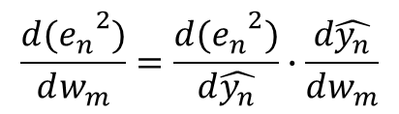
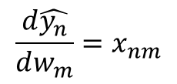
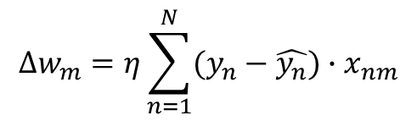
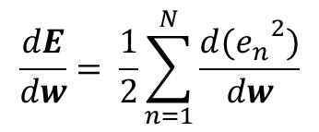


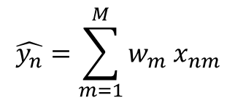
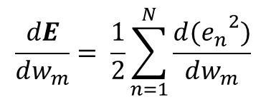
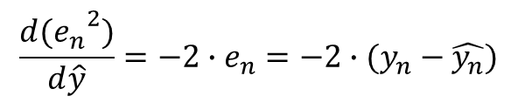
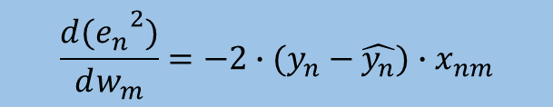
Least Square
$$\hat{y_{n}}=\sum_{m=1}^{M}{w_{m} x_{nm}}$$
$$e_{n}=y_{n}−\hat{y_{n}},$$
$$\frac{dE}{dw}= \frac{1}{2}\sum_{n=1}^{N}{\frac{d{(e_{n}}^{2})}{dw}}$$
$$\frac{d{(e_{n}}^{2})}{dw_{m}}=\frac{d{(e_{n}}^{2})}{d\hat{y_{n}}}∙\frac{d\hat{y_{n}}}{dw_{m}}$$
$$\frac{dE}{dw_{m}}= \frac{1}{2}\sum_{n=1}^{N}{\frac{d{(e_{n}}^{2})}{dw_{m}}}$$
$$\frac{d{(e_{n}}^{2})}{d\hat{y}}=−2∙e_{n}=−2∙(y_{n}−\hat{y_{n}})$$
$$→$$
$$\frac{d\hat{y_{n}}}{dw_{m}}=x_{nm}$$
$$∆w =η{∙E}^{′}(w^{k})$$
$$∆w_{m}=η\sum_{n=1}^{N}{(y_{n}−\hat{y_{n}})∙x_{nm}}$$
$$\frac{d{(e_{n}}^{2})}{dw_{m}}=−2∙(y_{n}−\hat{y_{n}})∙x_{nm}$$
$$∆w=η{ 𝕏}^{T}(Y−\hat{Y})$$

Slide 15
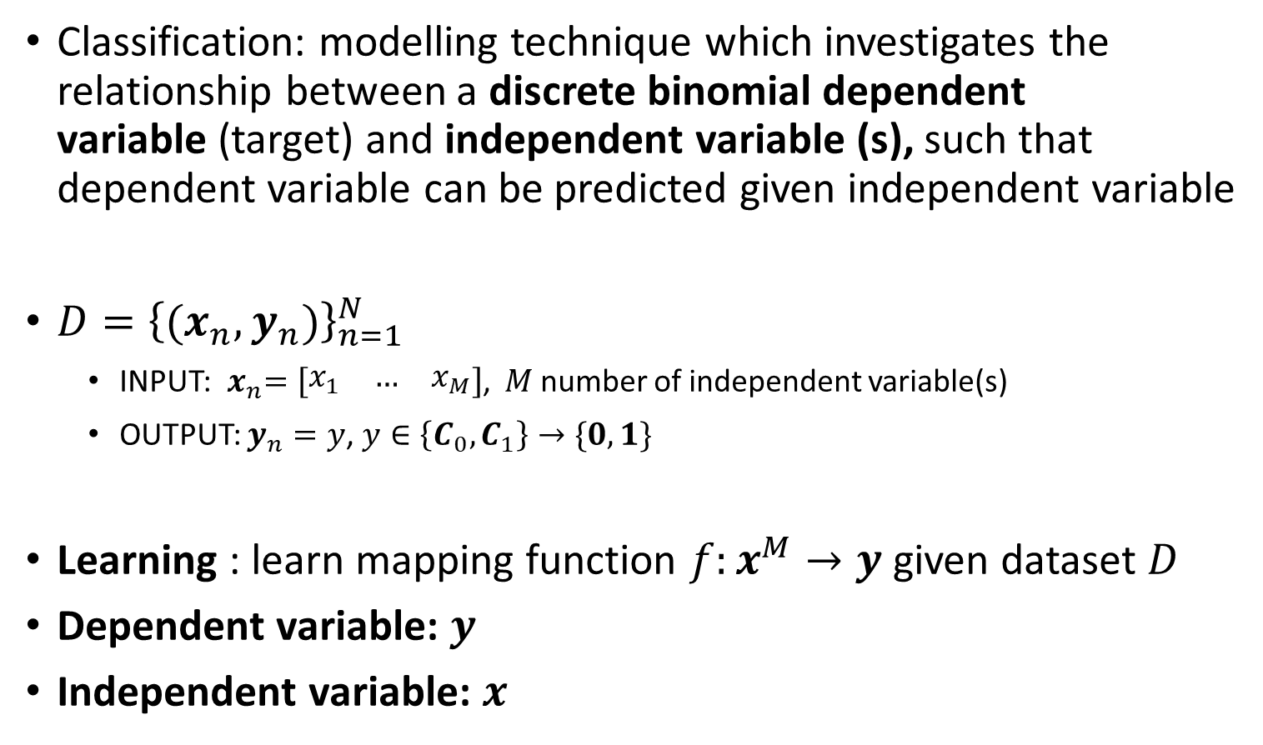
Logistic Regression/Classification
Classification: modelling technique which investigates the relationship between a discrete binomial dependent variable (target) and independent variable (s), such that dependent variable can be predicted given independent variable
${D=\left\{{(x}_{n}, y_{n})\right\}}_{n=1}^{N }$
INPUT:${ x}_{n}=\left[\begin{matrix}x_{1} & … & x_{M}\end{matrix}\right]$, $M$ number of independent variable(s)
OUTPUT: $y_{n}=y$, $y∈\left\{C_{0},C_{1}\right\}→\{0,1\}$
Learning : learn mapping function $f:x^{M}→y$ given dataset $D$
Dependent variable: $y$
Independent variable: $x$

Slide 16
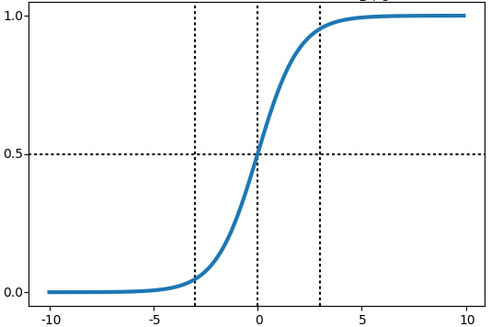
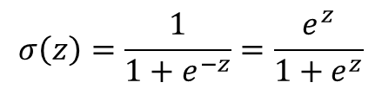


Sigmoid Function
$$σ\left(z\right)=\frac{1}{1+e^{−z}}=\frac{e^{z}}{1+e^{z}}$$
$$σ(z)$$
$$z$$

Slide 17
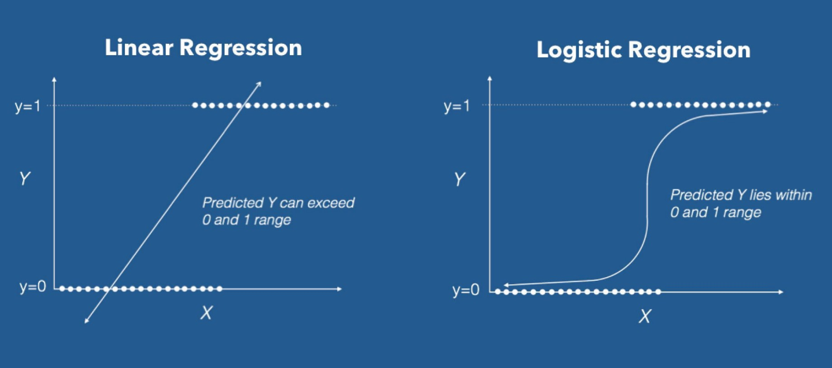



Logistic Regression
Use of sigmoid keep the output range between zero and one
$$z=w_{0}+\sum_{m=1}^{M}{w_{m} x_{m}}$$
$$y=w_{0}+\sum_{m=1}^{M}{w_{m}x_{m}}$$
$$y=σ\left(z\right)$$
$M$=1

Slide 18



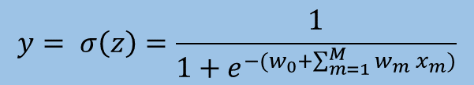
Logistic Regression
Can be view the output like a probability of class given features
$$z=w_{0}+\sum_{m=1}^{M}{w_{m} x_{m}}$$
$$σ\left(z\right)=\frac{1}{1+e^{−z}}$$
$$y=w_{0}+\sum_{m=1}^{M}{w_{m}x_{m}}$$
$$y= σ\left(z\right)=\frac{1}{1+e^{−(w_{0}+\sum_{m=1}^{M}{w_{m} x_{m}})}}$$
$M$=1

Slide 19
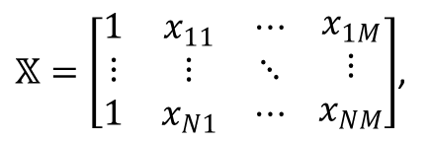
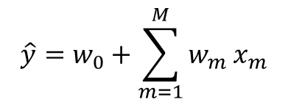
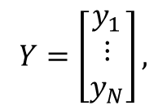
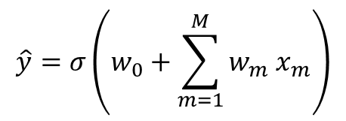


Logistic regression
$$X=\left[\begin{matrix}x_{11} & ⋯ & x_{1M} \\ ⋮ & ⋱ & ⋮ \\ x_{N1} & ⋯ & x_{NM}\end{matrix}\right],$$
$$Y=\left[\begin{matrix}y_{1} \\ ⋮ \\ y_{N}\end{matrix}\right],$$
$𝕏=\left[\begin{matrix}1 & x_{11} & ⋯ \\ ⋮ & ⋮ & ⋱ \\ 1 & x_{N1} & ⋯\end{matrix} \begin{matrix}x_{1M} \\ ⋮ \\ x_{NM}\end{matrix}\right]$,
$$w=\left[\begin{aligned}\begin{matrix}w_{0} \\ w_{1} \\ ⋮\end{matrix} \\ w_{M}\end{aligned}\right]$$
$$\hat{y}=σ\left(w_{0}+\sum_{m=1}^{M}{w_{m} x_{m}}\right)$$
$$⟹$$
$$\hat{Y}=σ\left(𝕏w \right)$$

Slide 20
Logistic Regression - MSE
$${MSE loss function= E}_{MSE}=\frac{1}{2}\sum_{n=1}^{N}{{(e_{n})}^{2} }=\frac{1}{2}\sum_{n=1}^{N}{{(y_{n}− {\hat{y}}_{n})}^{2} }$$
$$find{ w}^{∗}such that it minimize E$$
$$w^{∗}={argmin}_{w} E(w)$$
No-close form solution like linear regression
Solving it with Gradient Descent Optimization
$$w^{k+1}=w^{k}−η{∙E}^{′}(w^{k})$$
$$∇_{w}E=\frac{dE}{dw}= \left[\frac{dE}{dw_{0}},\frac{dE}{dw_{1}}, ⋯\frac{dE}{dw_{M}}\right]$$

Slide 21











Logistic Regression - MSE
$$z_{n}=w_{0}+\sum_{m=1}^{M}{w_{m} x_{nm}}$$
$${(e_{n})}^{2}{=(y_{n}−\hat{y_{n}})}^{2},$$
$\hat{y_{n}}=σ\left(z\right)$ ,
$σ\left(z_{n}\right)=\frac{1}{1+e^{−z_{n}}}$ ,
$$\frac{d{(e_{n})}^{2}}{dw_{m}}=\frac{d{(e_{n})}^{2}}{d\hat{y_{n}}}∙\frac{d\hat{y_{n}}}{dz_{n}}∙\frac{dz_{n}}{dw_{m}}$$
$$\frac{dE}{dw_{m}}= \frac{1}{2}\sum_{n=1}^{N}{\frac{d{(e_{n})}^{2}}{dw_{m}}}$$
$$\frac{d{(e_{n})}^{2}}{d\hat{y}}=−2∙e_{n}=−2∙(y_{n}−\hat{y_{n}})$$
$$\frac{dE}{dw_{m}}=−(y_{n}−\hat{y_{n}}∙σ^{,}\left(z_{n}\right)∙x_{nm}$$
$$\frac{d\hat{y}}{dz_{n}}=σ^{,}\left(z_{n}\right)=σ\left(z_{n}\right)(1−σ\left(z_{n}\right)$$
$$=\hat{y_{n}}(1−\hat{y_{n}})$$
$$∆w_{m}=η∙\sum_{n=1}^{N}{(y_{n}−\hat{y_{n}})∙σ^{,}\left(z_{n}\right)∙x_{nm}}$$
$$\frac{dz_{n}}{dw_{m}}=x_{nm}$$

Slide 22

Logistic Regression - MSE
0.25
$$σ^{,}\left(z\right)$$
0.00
0
$$σ\left(z\right)$$
1
weight update is $∆w_{m}=−η∙(y−\hat{y})∙σ^{,}\left(z\right)∙x_{m}$
When $\hat{ y}$=$σ\left(z\right)→$ closest to 0 or 1 ;${ σ}^{,}\left(z\right)$ become closest to zero
consequently update value closest to zero When output class value mismatch e.g. $(y,\hat{y}$)=(0,1) or (1,0)
However, in mismatch case, we desire greater update or change in weight→ above weight update form is not desirable

Slide 23


Entropy
Entropy : amount of uncertainty there is about the value of a variable
Information content
Randomness or uncertainty in the data
Measure of randomness
More uncertainty, more is the information…
$$entropy=H\left(p\right)=−\sum_{a}{p\left(a\right)log⁡(p(a))}$$

Slide 24
Cross Entropy
$$cross entropy=H\left(p,q\right)=−\sum_{a}{p\left(a\right)log⁡(q(a))}$$
How similar is two distribution, here $p and q$
For binary outcome
1
$binary cross entropy=H\left(p,q\right)=−$( $plog⁡(q)$ + $(1−p)log⁡(1−q)$ )
1
Higher the similarity between $p and q$ , lower is the cross entropy $H\left(p,q\right)$
$$p$$
0
$$q$$
1

Slide 25




Cross Entropy
How similar is two distribution, here $p and q$
For binary outcome
$binary cross entropy=H\left(y_{n},\hat{y_{n}}\right)=−$($y_{n}log⁡(\hat{y_{n}})$ + $(1−y_{n})log⁡(1−\hat{y_{n}})$ )
$$H\left({ y}_{n},\hat{y_{n}}\right)$$
Higher the similarity between ${ y}_{n} and \hat{y_{n}}$, lower is the cross entropy $H\left({ y}_{n},\hat{y_{n}}\right)$
$$\hat{y_{n}}$$

Slide 26

Logistic Regression - CE
With use of sigmoid activation function we restricted our outcome between 0 to 1; lets say probability
Our objective is to maximize the similarity between our target output and predicted out; that mean minimizing the cross entropy
Binary cross entropy can be used for loss or cost or error function
$Binary cross entropy=H\left(y,\hat{y}\right)=−$($y log⁡(\hat{y})$ + $(1−y)log⁡(1−\hat{y})$ )

Slide 27









Logistic Regression - CE
$$e_{n}=−\text{(}y_{n}log⁡(\hat{y_{n}})\text{ + }(1−y_{n})log⁡(1−\hat{y_{n}})\text{ )},$$
$$z_{n}=w_{0}+\sum_{m=1}^{M}{w_{m} x_{nm}}$$
$σ\left(z_{n}\right)=\frac{1}{1+e^{−z_{n}}}$ ,
$\hat{y_{n}}=σ\left(z\right)$ ,
$$\frac{de_{n}}{dw_{m}}=\frac{de_{n}}{d\hat{y_{n}}}∙\frac{d\hat{y_{n}}}{dz_{n}}∙\frac{dz_{n}}{dw_{m}}$$
$$\frac{dE}{dw_{m}}= \frac{1}{2}\sum_{n=1}^{N}{\frac{de_{n}}{dw_{m}}}$$
$$\frac{de_{n}}{d\hat{y_{n}}}=−\frac{y−\hat{y_{n}}}{\hat{y_{n}}(1−\hat{y_{n}}) }$$
$$\frac{de_{n}}{dw_{m}}=−(y_{n}−\hat{y_{n}})∙x_{m}$$
$$∆w_{m}=η∙\sum_{n=1}^{N}{(y_{n}−\hat{y_{n}})∙x_{nm}}$$
$$\frac{d\hat{y_{n}}}{dz_{n}}=σ^{,}\left(z_{n}\right)=σ\left(z_{n}\right)\left(1−σ\left(z_{n}\right)\right)$$
$$=\hat{y_{n}}(1−\hat{y_{n}})$$
$$\frac{dz_{n}}{dw_{m}}=x_{nm}$$
$$∆w=η{ 𝕏}^{T}(Y−\hat{Y})$$

Slide 28




Logistic Regression
For Binary Classification Problem
Sigmoid activation function
Binary cross entropy as cost function
Gradient descent based optimization..
We can use other optimization technique…
$$Y=\left[\begin{matrix}y_{1} \\ ⋮ \\ y_{N}\end{matrix}\right],$$
$𝕏=\left[\begin{matrix}1 & x_{11} & ⋯ \\ ⋮ & ⋮ & ⋱ \\ 1 & x_{N1} & ⋯\end{matrix} \begin{matrix}x_{1M} \\ ⋮ \\ x_{NM}\end{matrix}\right]$,
$$w=\left[\begin{aligned}\begin{matrix}w_{0} \\ w_{1} \\ ⋮\end{matrix} \\ w_{M}\end{aligned}\right]$$
$$∆w_{nm}=η(y_{n}−{\hat{y}}_{n})x_{nm}$$
$$∆w=η{ 𝕏}^{T}(Y−\hat{Y})$$

Slide 29



Activation function and cost function selection (at output node)
✔
Linear Regression (linear activation + MSE cost function)
Useful for regression or function approximation for unbounded continuous outcome
Logistic Regression (sigmoid activation + BCE cost function)
Useful for classification
Regression (sigmoid activation + MSE cost function)
$$∆w_{m}=η∙(y−\hat{y})∙x_{m}$$
✔
$$∆w_{m}=η∙(y−\hat{y})∙x_{m}$$
✘
$$∆w_{m}=η∙(y−\hat{y})∙σ^{,}\left(z\right)∙x_{m}$$

